Slide 1
Retail Business Intelligence & Customer Analytics Using SQL

Slide 2
agenda
Data Table description
Goal & focus
Process conducted
Segment based analysis

Slide 3
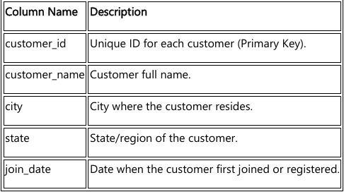
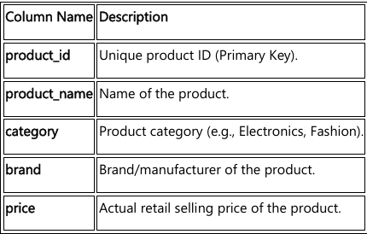
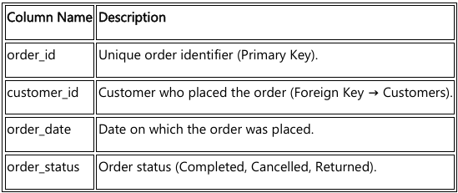
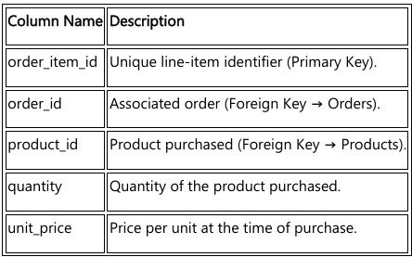
Data Table Description
Customer Table
Customer details(customer_id,name,city,state,join_date)
Products Table
Product details(product_id,name,category,brand,price)
Orders Table
Customer order details(order_id,date,status)
Order_items Table
Products detail(product_id,unit_price,quantity)
Sales_target Table
Sales details(year,month,target_sales)

Slide 4
Goal & Focus
Project Goal :
To analyze customer purchasing behavior, product performance, and revenue trends using SQL by transforming raw transactional data into meaningful business insights.
Key Focus Areas :
Sales performance analysis (revenue, monthly trends, state-wise performance)
Customer behavior analysis (RFM analysis, inactive customers, purchase patterns)
Product insights (top-selling products, frequently bought together items, brand/category performance)

Slide 5
Process Conducted :
Data Acquisition :
Initial schema review of 5 core tables ( customer, order, order_items, customers ,sales_target
2. Data cleaning & validation :
Confirmed NO NULL values in primary/critical columns
Confirmed NO DUPLICATE rows across all primary keys
3. Analysis & Transformation :
Used JOINS to link order, category, customer and sales target data
Employed windows functions(RANK,LAG) for comparative analysis
Applied aggregative function like Sum,average,count for key metrics like revenue,sales etc

Slide 6
Date and Time based Analysis

Slide 7
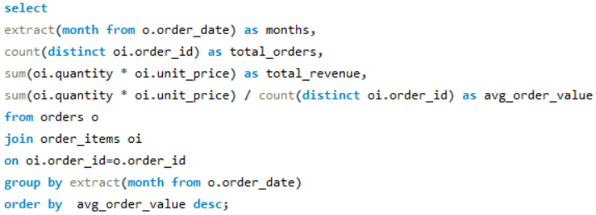
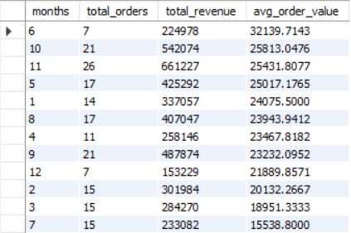
1. Monthly Sales Report
Observation :
Month 11 shows the highest revenue and order volume, indicating peak sales performance.
Month 6 has the highest average order value, highlighting the impact of high-value purchases.

Slide 8
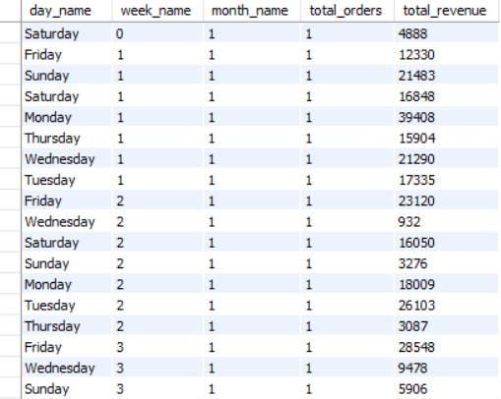
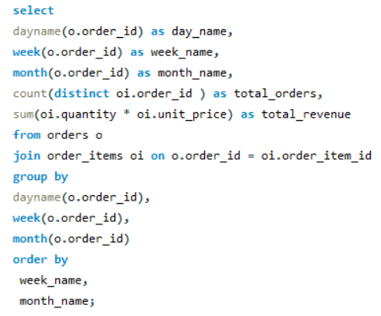
2. Sales Trends by Day, Week, Month
Observation :
Week 1 shows consistently higher revenue across most weekdays, indicating strong sales performance at the beginning of the month.

Slide 9
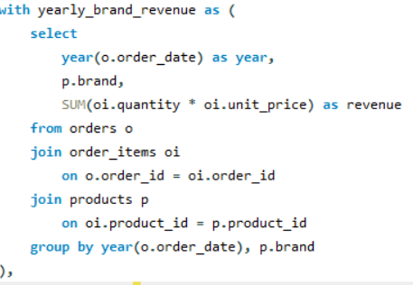

3. Top 3 Brands per Year
Observation :
In 2023, BrandB generated the highest revenue, ranking first among all brands.
BrandC and BrandD followed in second and third positions, showing competitive but lower performance compared to BrandB.

Slide 10
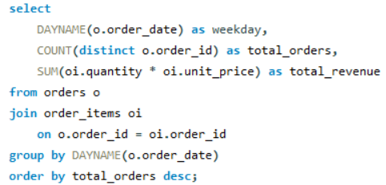
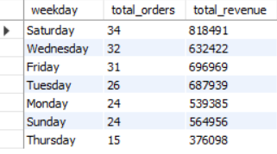
4. What is the peak shopping time?
Observation :
Saturday records the highest total orders and revenue, making it the strongest sales day of the week.
Thursday shows the lowest performance, indicating weaker customer activity compared to other weekdays.

Slide 11
State – wise sales
Analysis

Slide 12
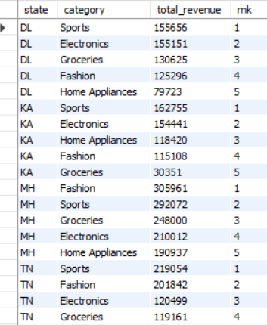
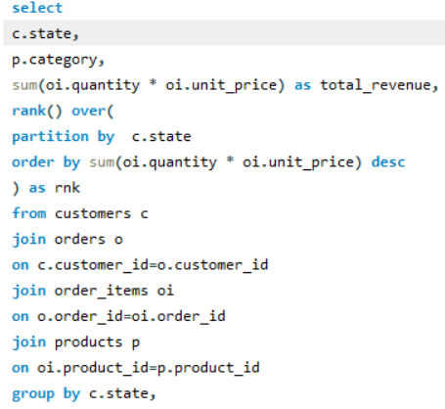
1. Top-Selling Category by State
Observation :
Sports category ranks first in most states (DL, KA, TN), showing consistently strong performance across regions.
In MH, Fashion leads revenue, highlighting regional variation in customer preferences by state.

Slide 13
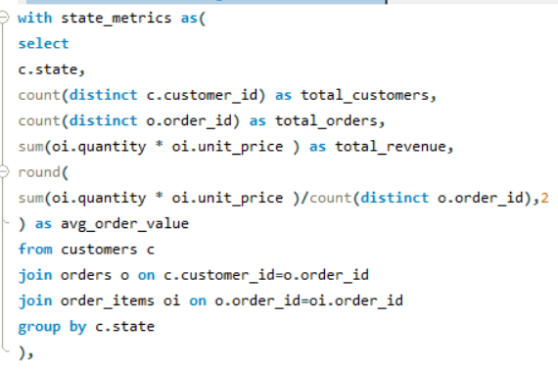
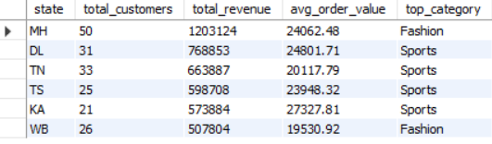
2. State-wise Customer Segmentation Dashboard
Observation :
MH has the highest total revenue (₹12,03,124) and customer count (50), with Fashion as its top category.
Most other states (DL, TN, TS, KA) show Sports as the top category, while WB has the lowest revenue and average order value among the listed states.

Slide 14
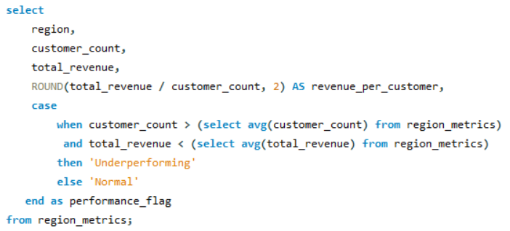
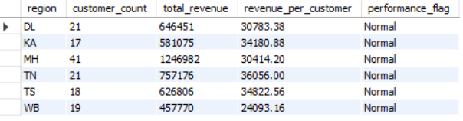
3. Which regions are underperforming despite having many customers?
Observation :
MH has the highest total revenue, while TN has the highest revenue per customer.
WB records the lowest revenue per customer, and all regions show Normal performance.

Slide 15
Sales based Analysis

Slide 16
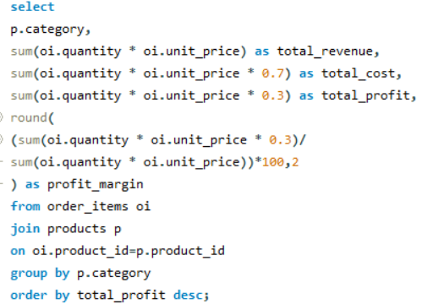
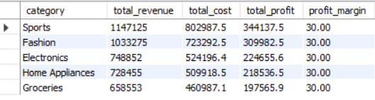
1. Category Profitability Analysis :
Observation :
Sports generates the highest revenue and profit, followed by Fashion.
All categories maintain a consistent 30% profit margin.

Slide 17
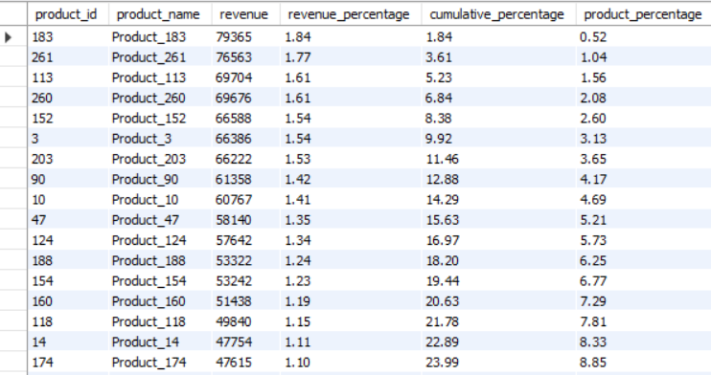
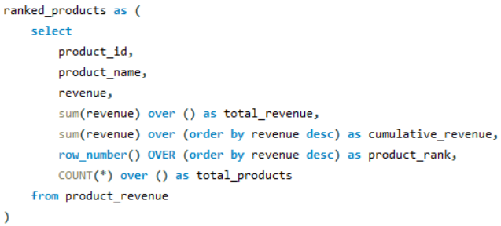
2. Which 20% of products bring 80% revenue :
Observation :
Product_183 generates the highest revenue, contributing 1.84% individually.
The top listed products together contribute nearly 24% of total revenue, showing a strong concentration among leading items.

Slide 18
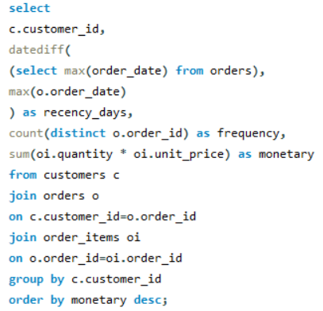
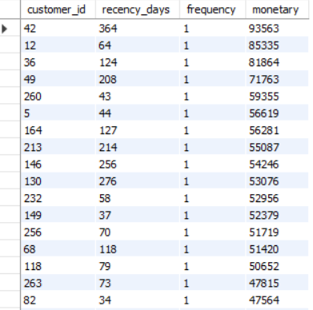
3. RFM Analysis (Recency, Frequency, Monetary) :
Observation :
All listed customers have purchased only once (frequency = 1), indicating low repeat engagement.
Customer 42 shows the highest monetary value but with very high recency (364 days), suggesting a high-value yet inactive customer.

Slide 19
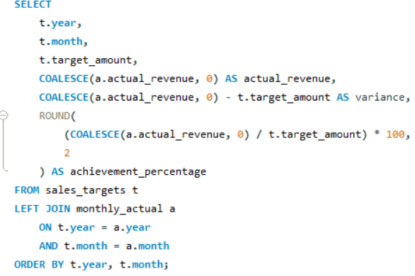
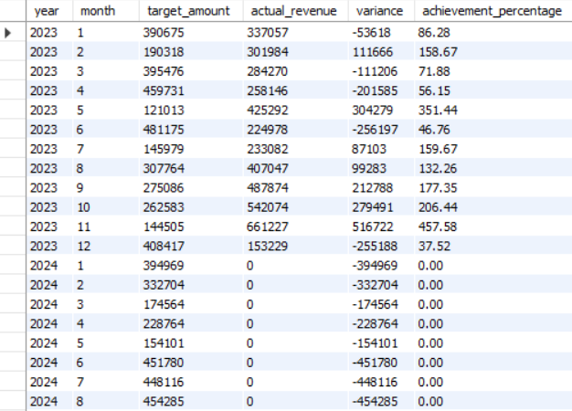
4. Are we hitting sales targets?
Observation :
In 2023, performance fluctuated significantly, with strong overachievement in months like November (457%) and major shortfalls in June and December.
In 2024, no revenue has been recorded so far, resulting in 0% achievement across all months.

Slide 20
Customer based Analysis

Slide 21
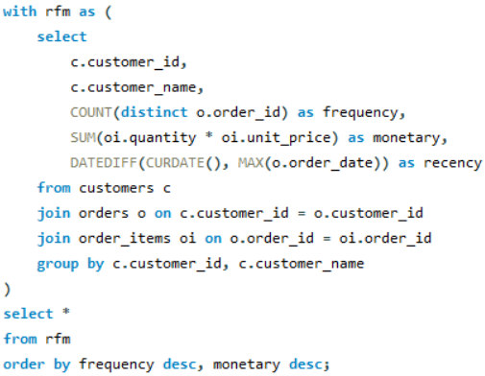
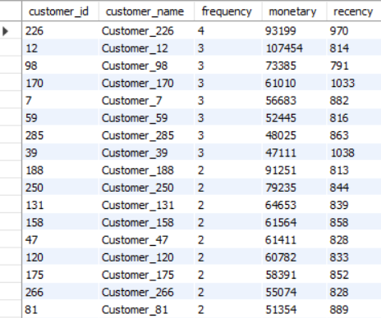
1. Which customers are most likely to reorder?
Observation :
Customer_226 has the highest purchase frequency (4), while Customer_12 generates the highest monetary value (₹1,07,454).
However, all customers show very high recency values (800+ days), indicating they are currently inactive.

Slide 22
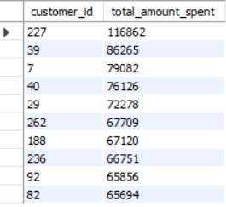
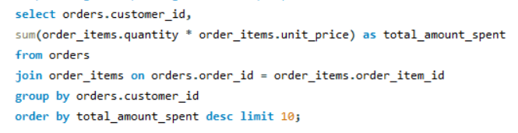
2. Top 10 Highest Spending Customers (LTV)
Observation :
Customer 227 is the highest spender with ₹1,16,862, significantly leading the list.
The remaining top customers show relatively close spending levels between ₹65K–₹86K.

Slide 23
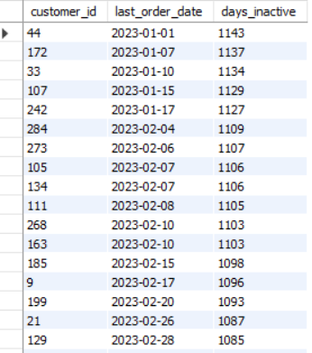
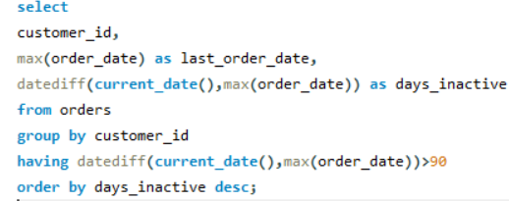
3. Identify Customers Inactive for 90+ Days
Observation :
These customers have been inactive for over 1,080 days, with their last orders placed in early 2023.
Customer 44 shows the highest inactivity (1,143 days), indicating a strong need for re-engagement strategies.

Slide 24
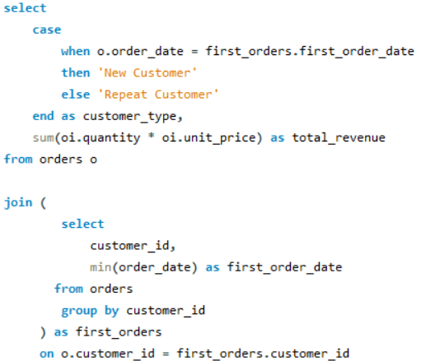

4. How much revenue comes from repeat vs new customers?
Observation :
New customers contributed higher revenue compared to repeat customers.

Slide 25
Product based Analysis

Slide 26
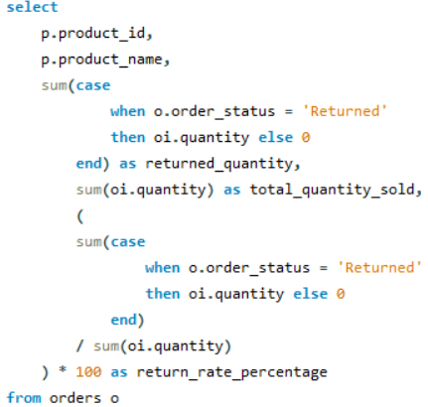
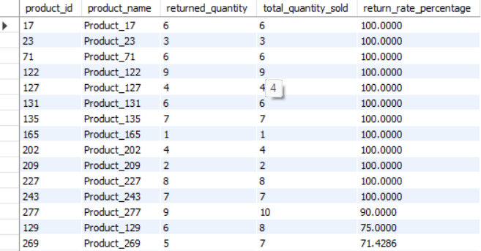
1. Which products get returned the most?
Observation :
Many products have a 100% return rate, meaning all sold units were returned.
Only a few products show slightly lower return rates, but returns are still high overall.

Slide 27
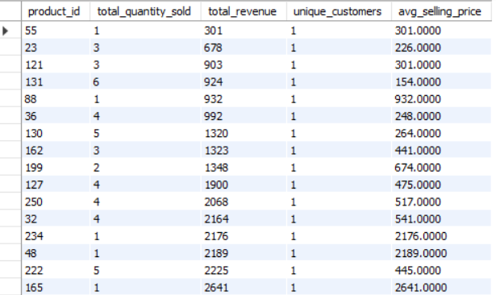
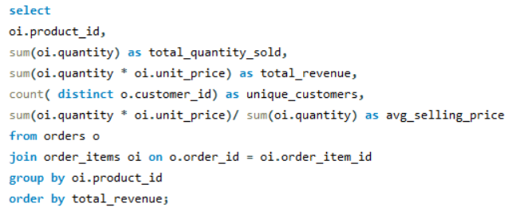
2. Product Performance Dashboard
Observation :
Some products generate high revenue with very few units sold due to a high average selling price.
Each product has only one unique customer, indicating no repeat purchases in this data.

Slide 28
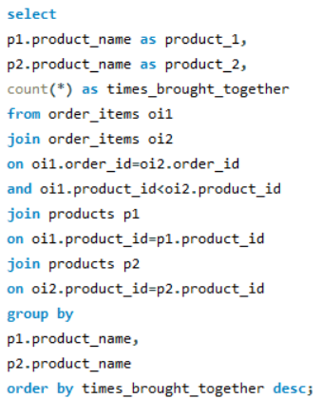
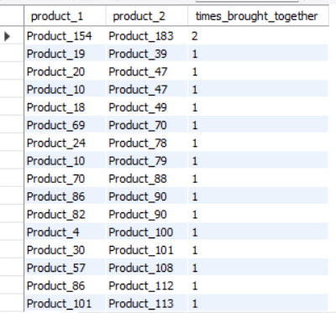
3. Frequently Bought Together Products
Observation :
Most product pairs were bought together only once, showing weak association between items.
Only Product_154 and Product_183 were purchased together more than once.

Slide 29
Thank you

